Slide 1

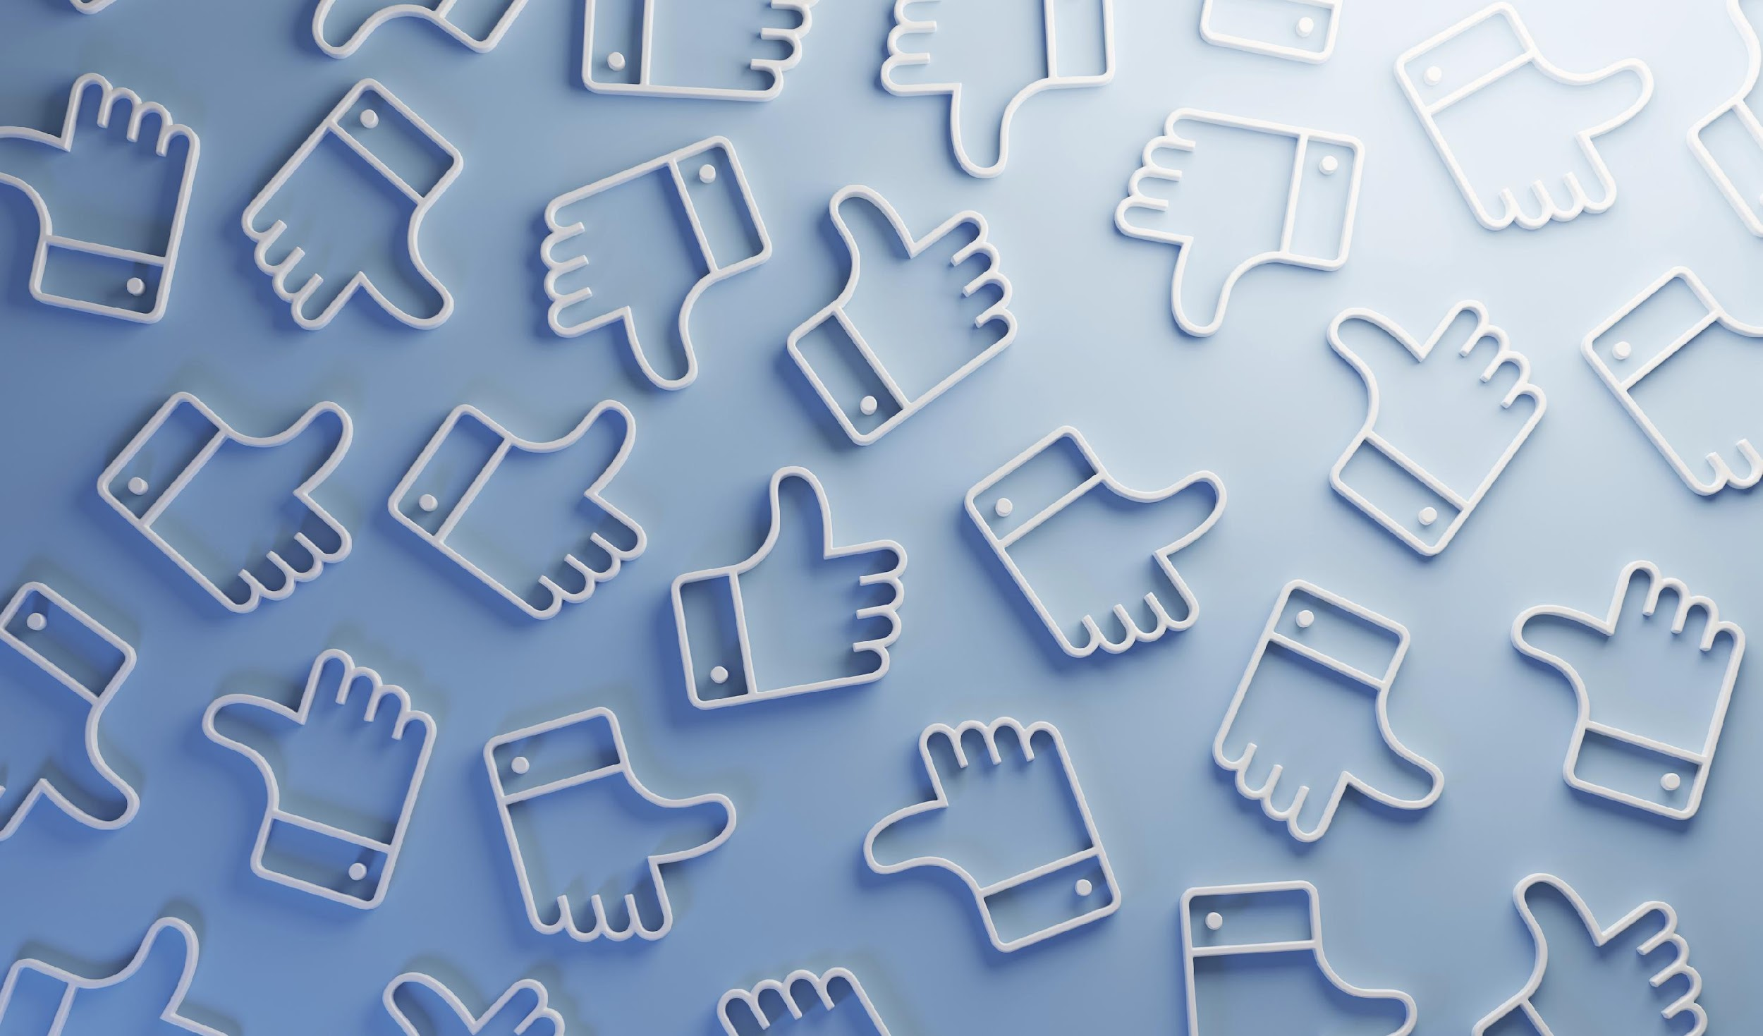


The Impact of Social Media
El Impacto de
Las Redes Sociales
on Mental Health
en La Salud Mental
Ontario-Montclair School District
Health & Wellness Services
Distrito Escolar de Ontario-Montclair
Servicios de Salud y Bienestar
MSW Intern 2025-2026
MSW Intern 2025-2026
Notes:
Hello, my name is _____, and I am an intern with OMSD Health & Wellness Services. Today, I will be giving a presentation on the impact of social media on mental health.

Slide 2
Objectives
Objetivos
Introduction
The Impact of COVID-19
Rise of Social Media Use
Positive/Negative Effects
Psychological Mechanisms
Building Healthy Habits
Conclusion
Resources
Introducción
El Impacto De El Coronavirus
Aumento Del Uso De Las Redes Sociales
Efectos Positivos/Negativos
Mecanismos Psicológicos
Creación De Hábitos Saludables
Conclusión
Recursos
Page 02
Notes:
- This is just a summary of a couple of the topics I am going to be talking about during this presentation.
*Name a few if you'd like, or continue forward*

Slide 3

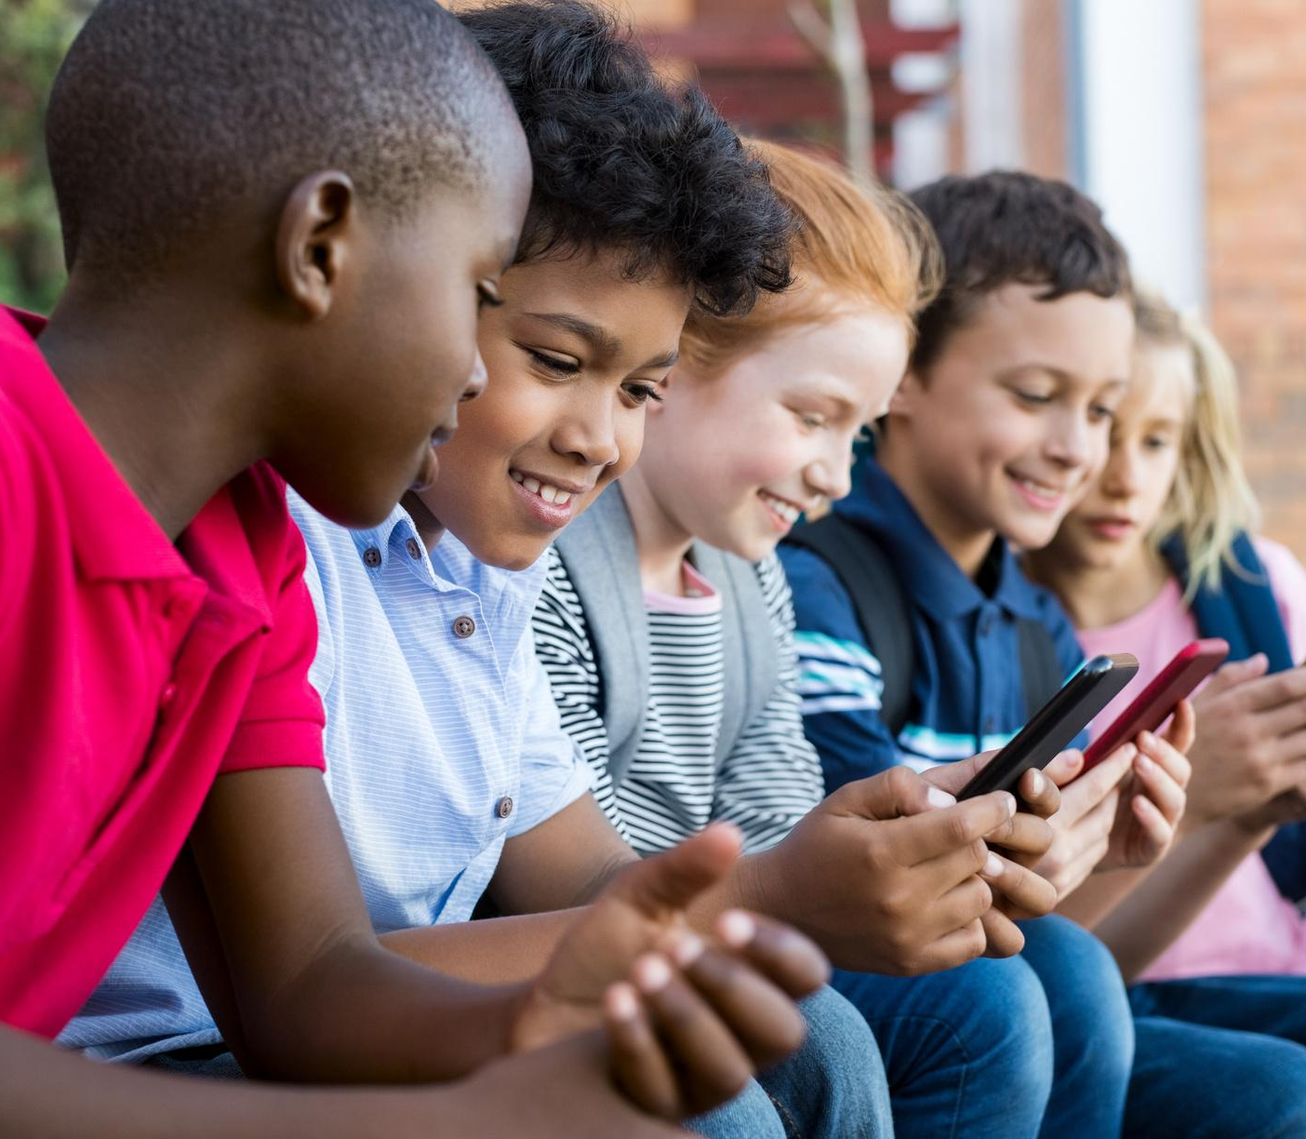

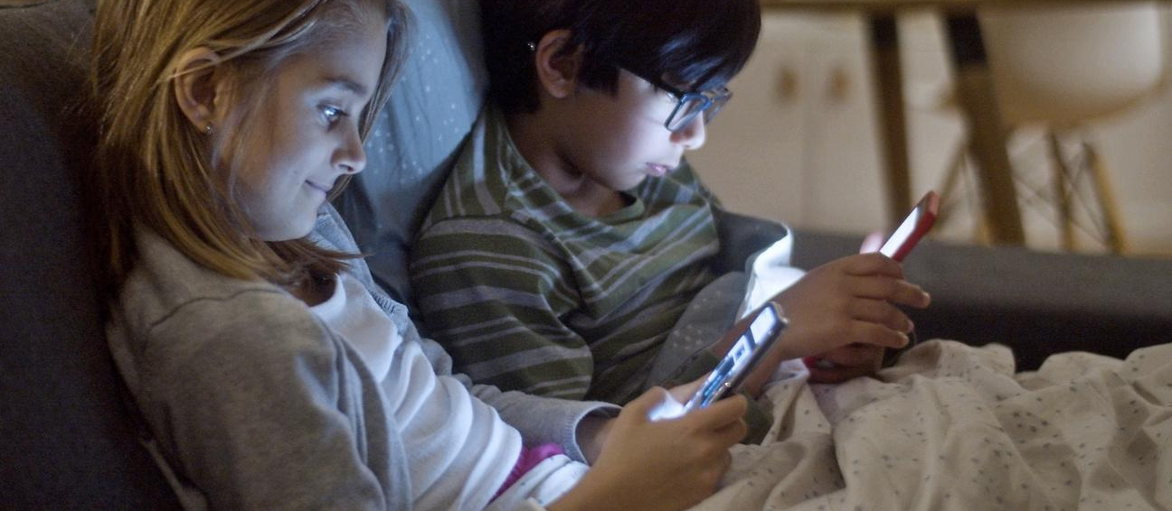
Introduction
Introducion
Social Media
As we know, over the last decades, the use of social media has continued to increase. Fundamentally, it changed the way we communicate and socially interact, and even impacted how we are able to access all kinds of information.
01
Redes Sociales
En las últimas décadas, el uso de las redes sociales ha seguido aumentando. Fundamentalmente, cambió la forma en que nos comunicamos, interactuamos y socializamos, e incluso afectó la forma en que podemos acceder todo tipo de información.
01
Page 03
Notes:
- Social media started becoming more popular around 2010.
- With the increased use of apps like MySpace, Facebook, and YouTube.
- Fundamentally, it completely changed our lives. It changed how we communicate, how we interact socially, and how we are able to access all sorts of information.

Slide 4
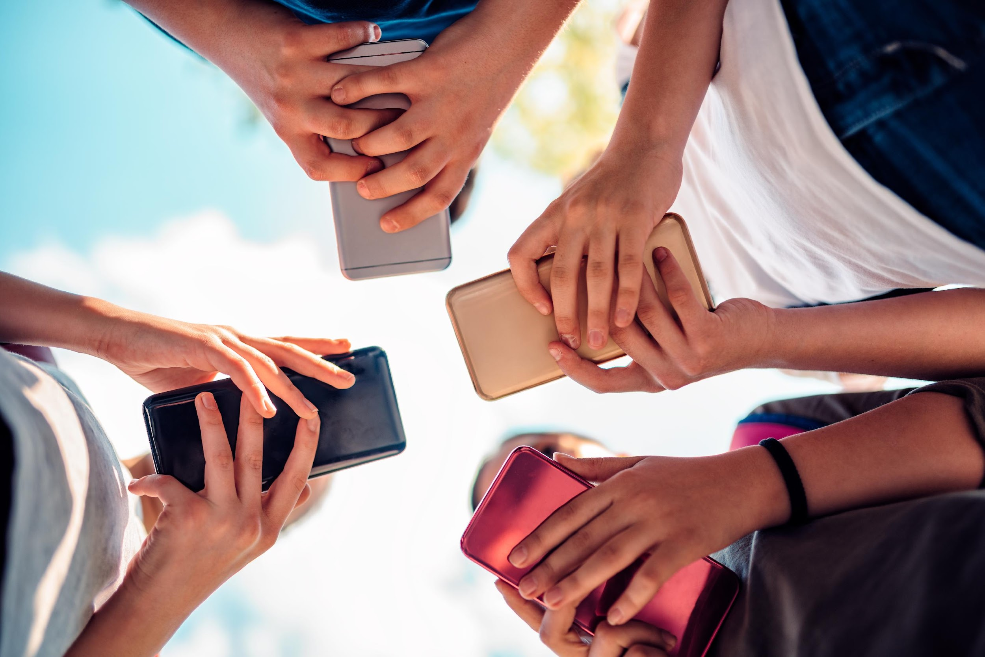
Lockdown
Increase in media device usage and internet access
Less face-to-face interaction
Problems with socialization
Feelings of isolation and loneliness
At-home Learning
COVID-19's Impact on Social Media Use
El Impacto del Coronavirus En El Uso De Las Redes Sociales
Cierre de emergencia
Aumento en el uso de las redes y mayor acceso a internet
Menos interacción social cara a cara
Dificultades socialiciando
Aislamiento y soledad
Aprendizaje en casa
Page 04
Page 05
Bozzola, E., Spina, G., Agostiniani, R., Barni, S., Russo, R., Scarpato, E., Di Mauro, A., Di Stefano, A. V., Caruso, C., Corsello, G., & Staiano, A. (2022). The Use of Social Media in Children and Adolescents: Scoping Review on the Potential Risks. International journal of environmental research and public health, 19(16), 9960. https://doi.org/10.3390/ijerph19169960
Notes:
- COVID-19 had many serious effects on different areas of our lives and the lives of our loved ones.
The infamous lockdown that started it all.
- This meant students were spending more time at home-- which increased their social media usage, where they were interacting less and less with others -- leading to problems with socialization we see now.
- In addition, at-home learning became a thing, classes were being taught through Zoom, and for many, this had a big impact. - Some students struggled with learning remotely; every student has different learning styles, and if their learning styles were not being met, it pushed back what they were actually grasping and learning.

Slide 5
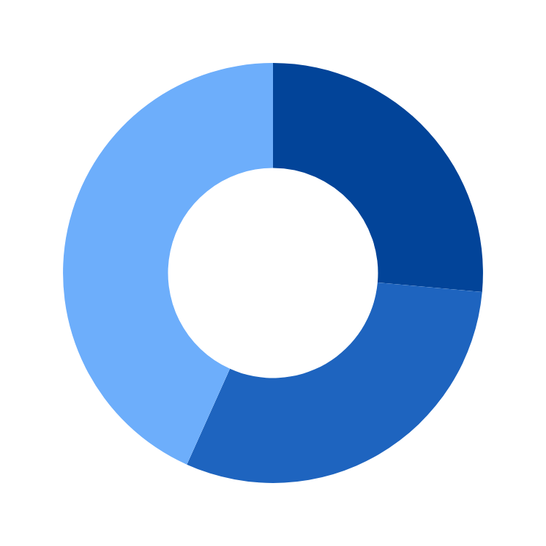
Rise of Social Media Use
Aumento Del Uso De Las Redes Sociales
61% Instagram
Pew Research Center survey of U.S. teens ages 13 to 17 conducted Sept. 18-Oct, 2025.
Encuesta del Pew Research Center a adolescentes estadounidenses de entre 13 y 17 años realizada entre el 18 de septiembre y el 20 de octubre de 2025.
90% Youtube
63% TikTok
Instagram
Tiktok
Youtube
Faverio, Michelle. (2024). Teens, Social Media, and Technology 2024. Pew Research Center. https://www.pewresearch.org/internet/2024/12/12/teens-social-media-and-technology-2024/
Page 05
Notes:
- Teens and even younger children are as digitally connected as ever.
- Most teens have phones or some sort of access to technology and/or social media from a very young age.
- According to a 2024 Pew Research Center survey of U.S. teens ages 13 to 17, conducted.
- That same survey indicates that the top three most used social media apps by teens are YouTube at 90%, TikTok at 63%, and Instagram at 61%.
Does this surprise anyone?

Slide 6
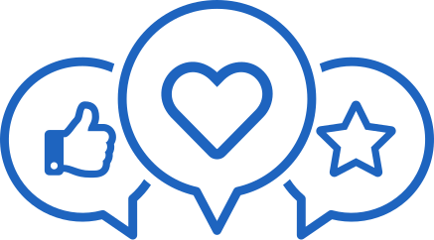

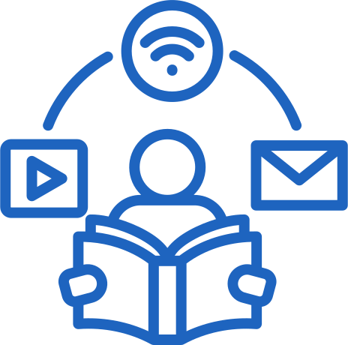
Positive Effects
Efectos Positivos
Communication
Comunicacion
Access To Information
Acceso A información
Creative Expression
Expresion Creative
Provides means to communicate with others
for school projects
Long-distance family members
Social support and connection
Connect with experts
Medios para comunicarse con los demás
para proyectos escolares
Familiares a distancia
Apoyo y conexión social
Conectar con expertos
Share interests
provides an outlet to creatively express themselves
Built-in audience
Compartir intereses
Proporcionar una salida para expresarse creativamente
Tienen una audiencia
Ability to access useful information quickly
Online tutoring
Homework help
Capacidad para acceder rápidamente a información útil
Tutoría en línea
Ayuda con los deberes
Page 06
Notes:
- Social media, however, can and does have many positive effects.
- The original purpose of social media was to connect people digitally.
- Fostering online communities that perhaps were not possible in person
- As mentioned, communication is a major positive.
- For instance, communicating with long-distance family members. It allows family members to keep in touch despite being so far away from one another.
- Access to information and creative expression are also major pluses to having access to social media.
* Read of 1-2 bullet points of each of these*

Slide 7




Negative Effects
Efectos Negativos
Anxiety and Depression
Isolation
Addiction
Online Harassment
Bullying
Stalking
Distraction
Loneliness
Academic Impact
Privacy Concerns
Data Exploitation
Sleep Disruption
Ansiedad y Depresión
Aislamiento
Adicción
Acoso En Línea
Acoso Escolar
Acoso
Distracción
Soledad
Impacto Académico
Preocupaciones Sobre La Privacidad
Explotación De Datos
Trastornos De Sueño
Page 07
Notes:
Just as social media has its positive effects, it also has its negative effects. Many of which can strongly negatively affect an individual's mental health.
- As you all can see, the list of possible negative effects is long.
- Some of the possible negative effects include anxiety and depression, bullying, distraction, academic impact, and sleep disruption.
- This does not necessarily mean all apply to each person. This is a generalization and varies for each person.

Slide 8
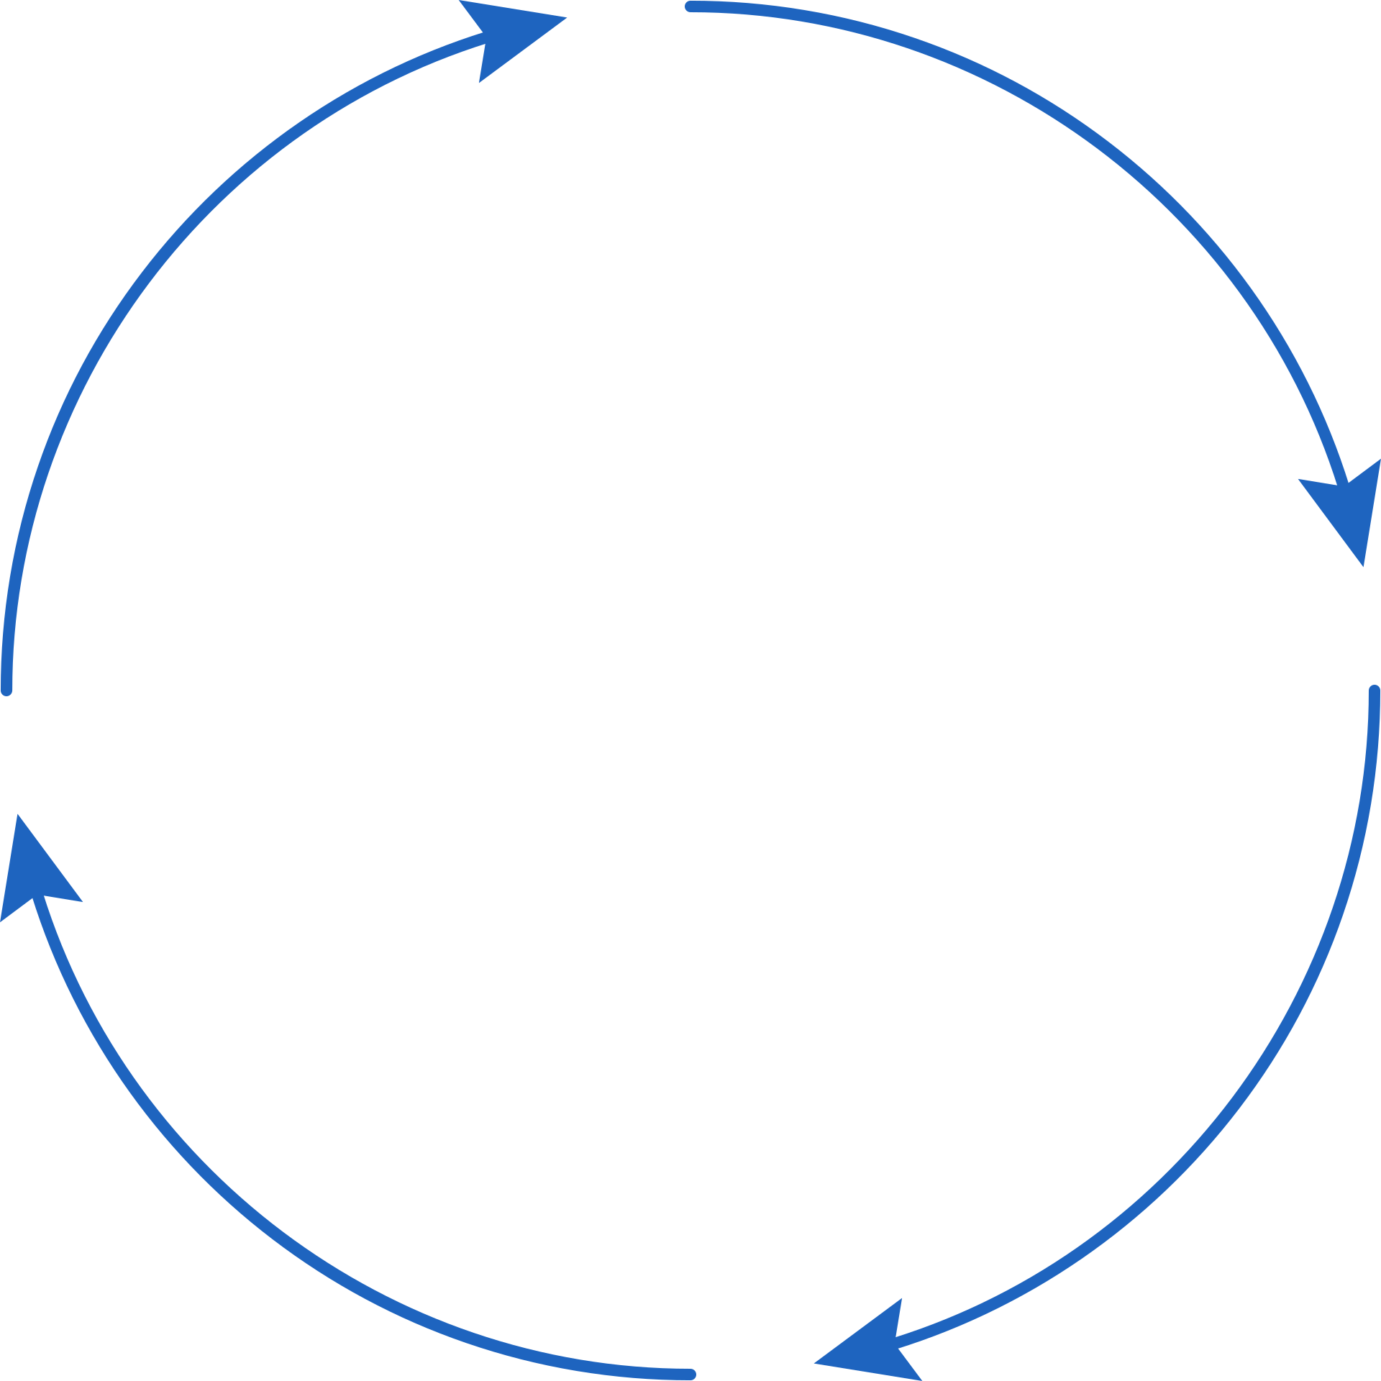
Psychological Mechanisms
Mecanismos Psicológicos
Dopamine hit
Descarga de Dopamina
Activates the brain’s reward center
Positive feedback
Leads to impulsive checking and addictive behaviors
Activa el centro de recompensa del cerebro
Los comentarios positivos
Conduce a comportamientos impulsivos y adictivos.
Miedo a Perderse Algo (FOMO)
Fear of Missing Out (FOMO)
Provoca ansiedad e inquietud
Uso excesivo
Comprobación compulsiva
Uso excesivo de las redes sociales
Drives anxiety and restlessness
Overuse
Compulsive checking
Excessive social media use
Elkatmış M. (2024). Examination of social media usage habits of generation Z. Frontiers in psychology, 15, 1370823. https://doi.org/10.3389/fpsyg.2024.1370823
Page 08
Notes:
Using social media can affect some psychological mechanisms.
What are psychological mechanisms?
-Psychological mechanisms are like a built-in mental process or function that influences your thoughts, feelings, and behaviors.
When using social media for prolonged periods of time, individuals can experience dopamine hits and the fear of missing out or (FOMO)
Dopamine Hit:
.
The fear of being excluded or missing out on important events and interactions drives excessive social media use.
Anxiety & Restlessness:
.
FOMO creates anxiety and restlessness, contributing to compulsive checking and prolonged engagement on platforms.

Slide 9


Building Healthy Habits
Crear Hábitos Saludables
Screen time limits
Límites de tiempo de pantalla
Unfollow toxic content
No sigan contenido tóxico
Mute notifications
Silenciar notificaciones
Reduces distractions
Allows you to be present
Encourages authentic relationships
Breaks the cycle of seeking validation
Reduce las distracciones
Te permite estar presente
Fomenta las relaciones auténticas
Rompe el ciclo de búsqueda de validación
Better time management
Enhances focus and productivity
Can improve sleep quality
Mejor uso del tiempo
Mejora la concentración y la productividad
Puede mejorar la calidad del sueño
Reduces stress, anxiety, feelings of inadequacy
It means prioritizing your mental health
Curate the feed you want
Reduce el estrés, la ansiedad y los sentimientos de insuficiencia
Significa dar prioridad a tu salud mental
Crea el contenido que deseas ver
Page 9
Notes:
We often hear the negatives that are associated with a topic and what we shouldn't do. But what are some things we CAN do to aid in decreasing the negative effects previously mentioned?
- Set limits!
- This can look like many different things; maybe you are allowing yourself 1 hour of screen time before you start your homework. Or you create a reward system. When you complete ___ assignement you'll allow yourself an 1 hour of screen time before you do your next task.
- You can manage your time better and ensure that doom scrolling is not taking away your time for productivity.
- Better sleep! Scrolling can keep you up for hours! Prioritize sleep. Good night's rest = more energy vs the contrary.
- Unfollowing toxic content will help your mental health in ways you cannot imagine! We consume so much negative content without even realizing that much of what we see or hear starts influencing our choices and way of thinking.
- Remember, you can take charge of YOUR algorithm.
- Muting or silencing notifications will help you from being distracted.

Slide 10
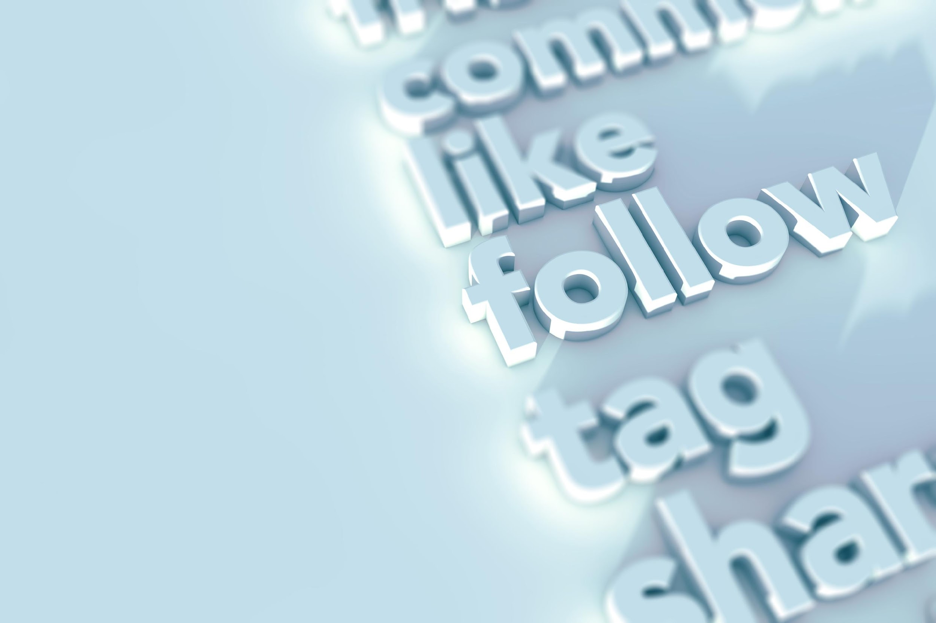
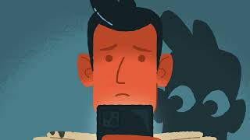
Social Media and Mental Health
Las Redes Sociales y La Salud Mental
https://www.youtube.com/watch?v=uTZXjvcsMlU
Page 10
Notes:
Now we will watch a short video on how social media impacts our mental well-being.
* play video *
If you are more of a visual learner, I hope the visuals in the video were able to get the points across that were previously mentioned.
But I want to reiterate what the speaker said at the end of the video, "When you meet social media on your terms, your screen time can start feeling like quality time again."
THAT'S HUGE! We often forget how using our socials truly becomes a habit. How many of you find yourselves constantly checking your phone or opening the same app you had already opened 2 minutes ago?
Currating a plan that works for YOU is the best you can do for yourself.

Slide 11
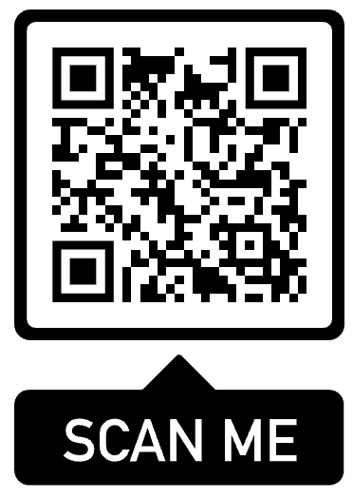
Additional Resources
Recursos Adicionales
Direct Link to CDC Mental Health Resources Website
Enlace directo para el sitio web de recursos para la salud mental
Taking Immediate action
Getting Help
Treatment and Support
Resources
Tomar medidas inmediatas
Obtener ayuda
Tratamiento y apoyo
Recursos
Page 12
Notes:
Here are a couple of additional resources.
*Ask them all to pull out their phones and scan the QR code*
When you scan the QR code, you get directed to the CDC Mental Health Resources.
I think it is a wonderful tool as it is categorized by need.
Such as:
- Getting Help
- Treatment
- And other resouces

Slide 12

Conclusion
Conclusión
Responsible Use
Excessive use is linked to negative mental health outcomes
Gaining self-awareness about how we use social media can help prevent negative effects in relation to mental health
Uso Responsable
El uso excesivo está relacionado con efectos negativos para la salud mental
Tomar conciencia de cómo utilizamos las redes sociales puede ayudar a prevenir efectos negativos en relación con la salud mental
Page 11
Notes:
To conclude, if there is something I want you all to take away from this presentation, it is for you to be aware of your social media use and use it responsibly.
- As we learned, though there are positives, there are many negative mental health outcomes that are linked to the overuse of social media.
*Thank the audience for listening and ask if there are any questions*

Slide 13
References/Referencias
American College of Pediatricians. (2025). Media use and screen time - its impact on children, adolescents, and families. https://acpeds.org/media-use-and-screen-time-its-impact-on-children-adolescents-and-families/
Bozzola, E., Spina, G., Agostiniani, R., Barni, S., Russo, R., Scarpato, E., Di Mauro, A., Di Stefano, A. V., Caruso, C., Corsello, G., & Staiano, A. (2022). The Use of Social Media in Children and Adolescents: Scoping Review on the Potential Risks. International journal of environmental research and public health, 19(16), 9960. https://doi.org/10.3390/ijerph19169960
Elkatmış M. (2024). Examination of social media usage habits of generation Z. Frontiers in psychology, 15, 1370823. https://doi.org/10.3389/fpsyg.2024.1370823
Faverio, Michelle. (2024). Teens, Social Media, and Technology 2024. Pew Research Center. https://www.pewresearch.org/internet/2024/12/12/teens-social-media-and-technology-2024/
González-Padilla, D. A., & Tortolero-Blanco, L. (2020). Social media influence in the COVID-19 Pandemic. International braz j urol : official journal of the Brazilian Society of Urology, 46(suppl.1), 120–124. https://doi.org/10.1590/S1677-5538.IBJU.2020.S121

